Slide 1
Azure Load Balancer

Slide 2










Azure Load Balancer
Delivers high availability and network performance to your applications.
It is an OSI layer 4 (TCP and UDP) load balancer
Backend Pool
Frontend
Load Balancing Rules
And health probes
Load Balancer

Slide 3




Public Load Balancer

Slide 4







Internal Load Balancer

Slide 5
Load Balancer SKUs
Basic
Standard

Slide 6






Backend Pools
Standard SKU | Basic SKU
Any VM is a single virtual network, including a blend of VMs, availability sets, and VM scale sets | VMs in a single availability set or VM scale set

Slide 7
Load Balancer Rules
A load balancer rule is used to define how traffic is distributed to the backend pool.

Slide 8




















Session Persistence
The load balancer uses a 5-tuple
Source IP
Source Port
Destination IP
Destination Port
Protocol Type

Slide 9










Health Probes
Allow the load balancer to monitor the status of your app.

Slide 10

















Hands-On

Slide 11
You are working as a Cloud Solution Architect in ABC Inc. You need to deploy a multi-tier application. What should you recommend ensuring the management overhead is minimized
1 Vnet 1 Subnet
1 Vnet multiple subnet
Multiple Vnet 1 subnet
Multiple VNet multiple subnet

Slide 12
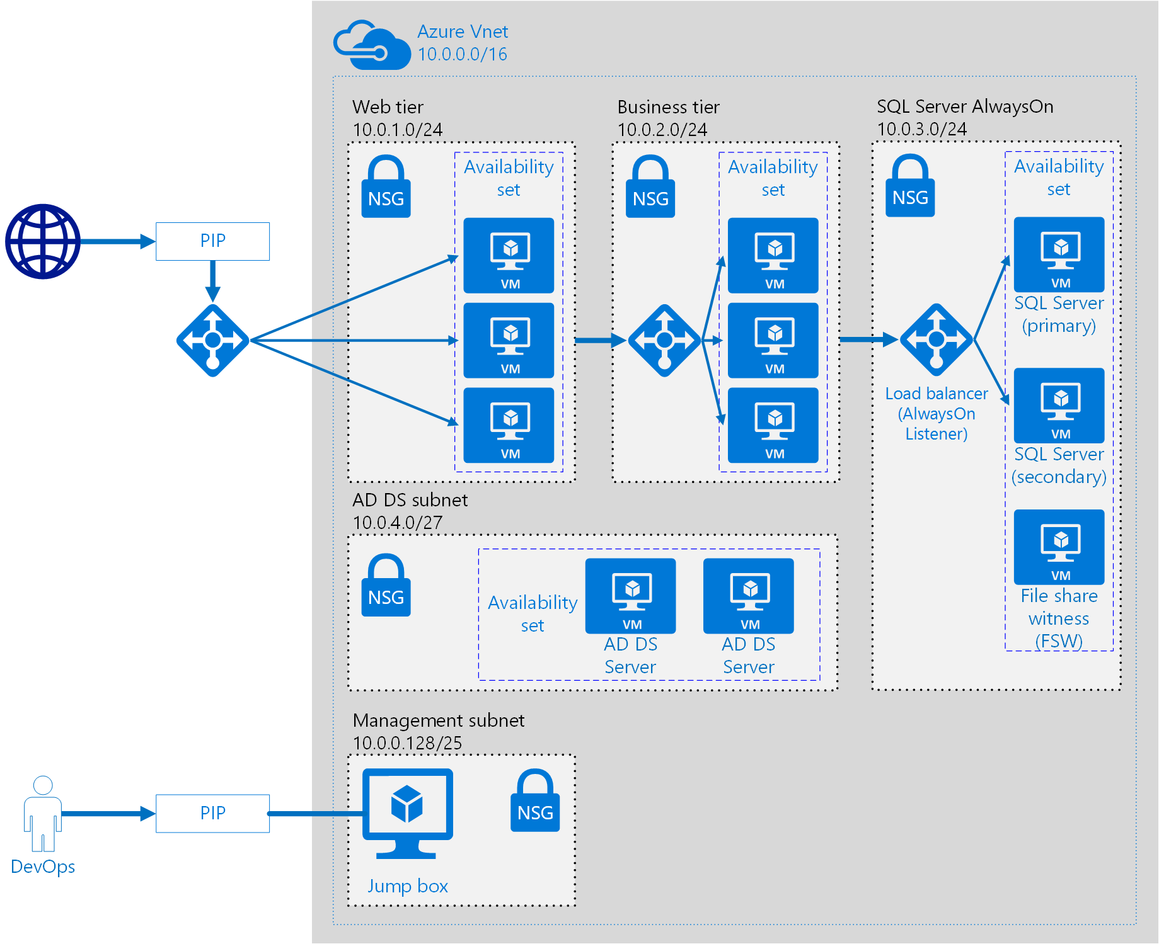

















Slide 13

















